Slide 1
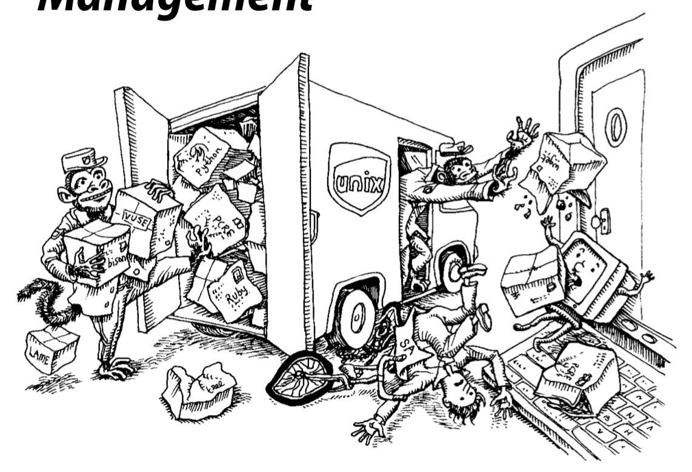
Software Installation and Management

Slide 2
Software Management at All Levels
Large parts of sysadmins jobs are doing the following:
Automating mass installation of operating systems
Maintaining custom OS configurations (“localization”)
Keeping systems and applications patched and up to date
Tracking software licenses
Managing add-on software packages
With fleets of any non-trivial size these tasks need to be highly automated and (when possible, which is almost always these days) done remotely
These types of network drive installation typically use DHCP and TFTP to boot the system, then receive the OS over the network through HTTP, NFS, or FTP
Notes:
DHCP = Dynamic Host Configuration Protocol
TFTP = Trivial File Transfer Protocol
HTTP = HyperText Transfer Protocol
NFS = Network File System
FTP = File Transfer Protocol

Slide 3
OS Installation Management

Slide 4
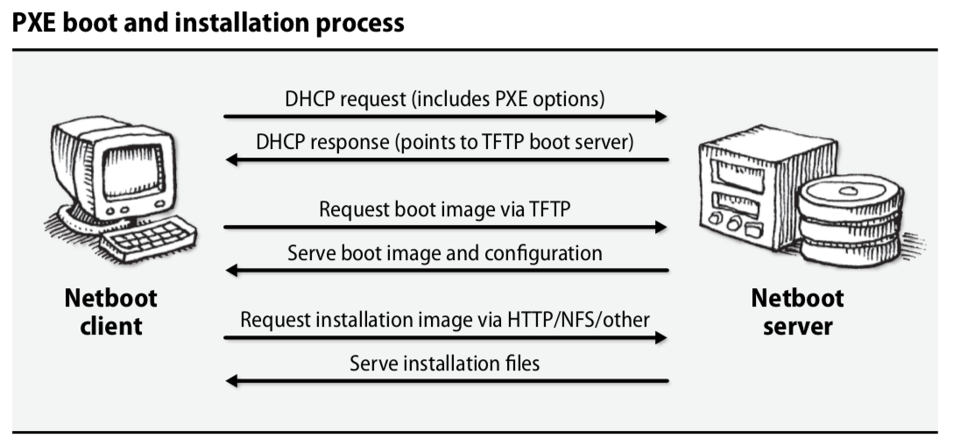
Preboot eXecution Environment (PXE)
Miniature OS that sits on network card (ROM) for PXE enabled machines
Coordinates between the network card and the BIOS to allow for boot images to be requested through the network and installed automatically
It then allows you to choose (or automate) an OS install from a server

Slide 5
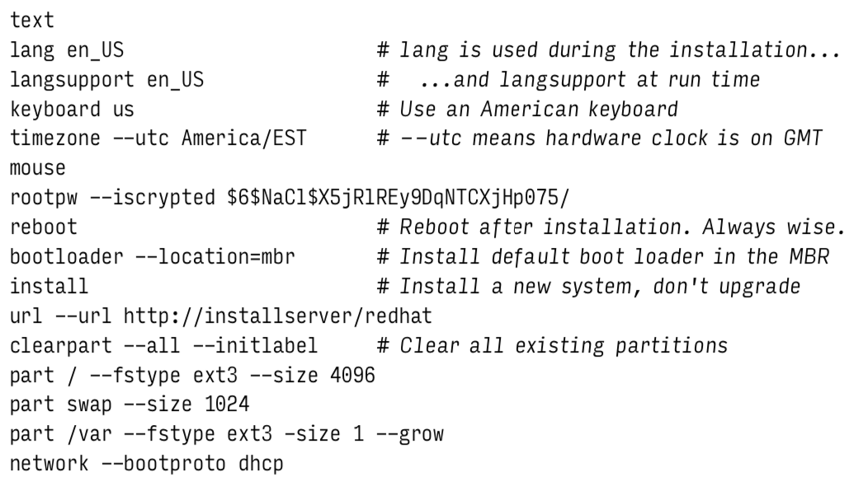
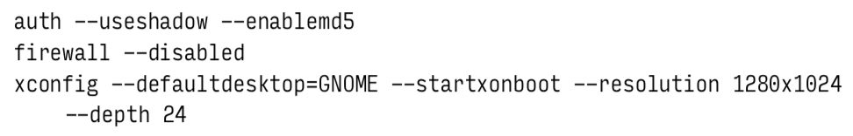
Kickstart for Red Hat and CentOS
Runs based on a preconfiguration file with three basic sections:
Command section, which specifies options such as language, keyboard, and time zone as well as source distribution (http here), root password, and hard drive partitions
Packages section, where packages and sets of packages that should be installed after the OS are listed
Pre/Post commands section, which allows you to specify arbitrary shell commands which should run %pre or %post installation
Notes:
Debian and Ubuntu have a similar system called debian-installer which uses a preconfiguration file to handle installation
Copy over additional information for the meaning of the parts of the preconfiguration file from p157
You can use this file by specifying linux inst.ks at the boot prompt or (better yet) use PXE to do it automatically.

Slide 6
Netbooting with Cobbler
Cobbler is an open source netbooting service (written by Michael DeHaan)
It bundles DHCP, DNS and TFTP services together and helps manage OS images for physical and virtual machines
Cobbler supports templates through the use of snippets which allow you to create a semi-standard template file which then references snippets for differentiation
Snippets allow you to manage machine variance easier such as time zone differences for geographically disparate machines, web vs. user configuration, and other situations where small variances occur in a manageable way
Cobbler can also work with a variety of hypervisors to manage OS installations for virtualized systems (VMs and containers)

Slide 7
Software Packages

Slide 8
Packages
Software used to be distributed as compressed archives that then needed to be uncompressed (and usually installed if it was software source)
Packaging systems have generally replaced this system, and include all the files needed to run a piece of software for a particular machine and OS combination
Source files, precompiled binaries, dependency information, and configuration file templates
Packages can run scripts which means they can add new users and groups, runs sanity checks, and customizes environmental settings
You can create custom packages for local applications or third party applications that aren’t normally installed, or even your own localizations

Slide 9
Packages
Packaging system typically don’t overwrite custom configurations, instead they create a backup when upgrading software or make a template configuration under a different name for admins to modify
This doesn’t always work as intended so it’s important to test package upgrades before rolling them out to the full fleet
Dependency awareness means packages will try and install all the software they depend on before trying to install themselves
This also can be incorrect, and lead to “dependency hell” where you cannot install a package because of version incompatibilities
Dependencies can also be utilize to create package groups, which are really just dependency lists that when installed install other sets of software

Slide 10
Low Level Package Management
The command rpm installs, verifies, and queries the status of packages while rpmbuild actually does the building of them from source
Primary flags to know for rpm are
-i (install)
-U (upgrade)
-e (erase)
-q (query)
The rpm system is aware of dependencies, but will not automatically handle the upgrading of necessary dependencies unless all are selected for upgrade at the same time (rpm does understand wildcard * character though)
Notes:
RPM is a recursive acronym which stands for “RPM package manager”

Slide 11
High Level Package Management
Metapackage management systems add several features that traditional package managers do not normally perform:
Simplify the task of locating and downloading packages
Automate the process of updating or upgrading systems
Manage the dependencies between multiple packages
In order for software to be distributed widely through a package metapackage manager it must have developer side tools to describe the software, its installation, its dependencies, and all other necessary extra steps
It also has a mechanism for describing where the packages can be acquired from to make querying a much simpler task, which can be utilized by sysadmins to separate internally approved packages from general ones

Slide 12
Package Repositories
Web of FTP server maintained by Linux distributors (or others), default configurations typically point to distributors own repository
Some common and useful terms for packages:
Release: a self-consistent snapshot of all the packages in the distribution
Component: a subset of software within a release. Distributors partition their releases differently but common ways are core vs. extra software and open-source vs. restricted
Architecture: the class of hardware that the package is meant for (x86_63, x86_32, etc.)
Package: architecture-specific independently versioned software, a collection of which makes up a release

Slide 13
Package Managers
The two major package management systems are the Advanced Package Tool (apt) and the Yellowdog Updater, Modified (yum)
Some important command that are (more or less) shared between the two managers:
apt/yum install <package-name>: installs the <package-name> assuming it exists in one of the registered repositories
apt update: updates the cached list of packages (including new versions) from the remote repositories
apt upgrade/yum update: updates all packages previously installed to the newest version
Notes:
Note that yum is generally slower because it looks to the network repositories each time an install or update happens so you are always looking at the newest packages while apt has a local cache that it uses for reference which needs to be updated before you can see that there are updates to individual packages.

Slide 14
Repository Configuration
The apt repositories are configured at /etc/apt/sources.list
Formatted: type mirror-uri distribution [components]
Good practice to change the mirror-uri to the closest mirror
Replace mirror-uri when using a local mirror rather than “remote”
Typically you add additional “nice to have” software repos to the list
The yum repositories are configured at /etc/yum.conf and /etc/yum.repos.d/*.repo
Additional repositories should be added as *.repo files
Recommended organization is one *.repo file per “nice to have” repo
Modify baseurl for repositories (there is also yum-config-manager)
Notes:
It is a good idea to use the same configurations as much as possible (or the same for a group of similar configured machines) to make upkeep and upgrading fleets of machines easier. You can do this through a central (and well watched) FTP server or through customization in the OS installation management step (either a custom ISO with these mirrors already set or by modifying the installation tree on your server).

Slide 15
Package Automation
Neither apt nor yum have built-in scheduling, but you can utilize the manager and cron or systemd timers to accomplish automated updating
apt update && apt upgrade -y
yum update -y
It is a bad idea to automatically update packages from distributor repositories since changes to the system may affect other software
This is especially true about development or production servers which are running custom written code on top of generic services
Rather than updating automatically from a distributor repository, use a locally controlled mirror repository which is only updated after (extensively) testing new software with your software and services

Slide 16
Local Repository Mirrors
Create your own FTP or HTTP(S) server which contains a subset of the available packages (usually based on version)
Use apt-mirror (non-standard, available on GitHub) to create an apt repository or re-create the directory structure used for a yum repository
Make the necessary directories available on your local network either through any web server or through an FTP server
This allows for faster fleet updates since you update the mirror over the internet but the fleet over the local network
You can test package updates before updating them on the mirror, meaning package upgrade automation is less likely to break systems

Slide 17
Local Network
Internet
Developer Server(s)
Distributor Controlled Package Repo(s)
Testing Machines
Production Server(s)
Network Router(s)
Employee Machines
Locally Controlled Package Mirror(s)
Email Server(s)
Notes:
All the machines that need to be updated (all the Unix machines) are connected to a locally controlled package mirror (or a number of locally controlled package mirrors). Administratores then test package updates on a subset of machines (typically allocated just for testing but matching the current configuration of machines in the fleet) and if there are no issues that arise from the new packages the mirror is updated with those versions. If you are using automated package updates on the fleet they will then pull the new (and verified) versions of the packages and update themelves. This update process can happen as often as the administrator (or other parties) want it to happen, however security patches should be prioritized when they are released (subscribe to mailing lists!)

Slide 18
Update Tips
Updates that cause changes to “user visible” software should be communicated to users in advance and you should solicit feedback about the possible change to see how it will affect users
Don’t roll out software updates en masse if you have a large fleet of machines, instead use either a “canary” deployment or a “hockey stick” deployment (depending on the number of machines)
Try and make small updates regularly rather than saving up a bunch of updates and patches for a single update, regular and gradual updates tend to have fewer issues than large and rare updates
Unless you enjoy being frustrated over the weekend, don’t roll out software updates on Fridays

Slide 19
Questions?

Slide 20
Additional Resources
Configuring PXE Boot For CentOS 6.5 Using FTP, HTTP, And Kickstart
RedHat Yum Cheat Sheet

